Slide 1
Big Data Analytics
Group-C
Group C
1. Dhairya Kathpalia[2021H1540832P]
2. Himani Singh[2021H1540822P]
3. Naman Dhameja[2021H1540829P]
4. Reshma Gadde[2021H1540820P]
5. Vishva Bhalodiya[2021H1540833P]
6. Vaibhav[2021H1540846P]

Slide 2
Content:
Introduction
Data Engineering
Approaches we followed
Final Model
Visualization
Conclusion

Slide 3
Introduction
We are using household power consumption Dataset which consists of measurements gathered in a house located in Paris, France between December 2006 and November 2010 (47 months).
The documentation identifies the following variables of interest:
date: Date in format dd/mm/yyyy
time: time in format hh:mm:ss
global_active_power: The total active power consumed by the household (kilowatts).
global_reactive_power: The total reactive power consumed by the household (kilowatts).
voltage: Average voltage (volts).
global_intensity: Average current intensity (amps).
sub_metering_1: Active energy for kitchen (watt-hours of active energy).
sub_metering_2: Active energy for laundry (watt-hours of active energy).
sub_metering_3: Active energy for climate control systems (watt-hours of active energy).

Slide 4
Data Engineering
1.Load the data using Spark API format as a pyspark.sql.dataframe.DataFrame
2.Splitting the Date and time as separate columns for date as day,month,year and for time hour,minute
3.Casting the datatypes in appropriate format
3.Handling missing values
4.Data transformation using Vector Assembler
5.Standard Scaling of data for each feature or variable to unit variance

Slide 5
Approaches we Followed
1.Initially as the data is time series data we approach to apply 3,5,7,9 period moving average as the data is highly volatile we switched to regressor methods
2.We have used four kind of Regression methods
Random Forest Regressor
Linear regression
Decision tree Regression
GBT

Slide 6
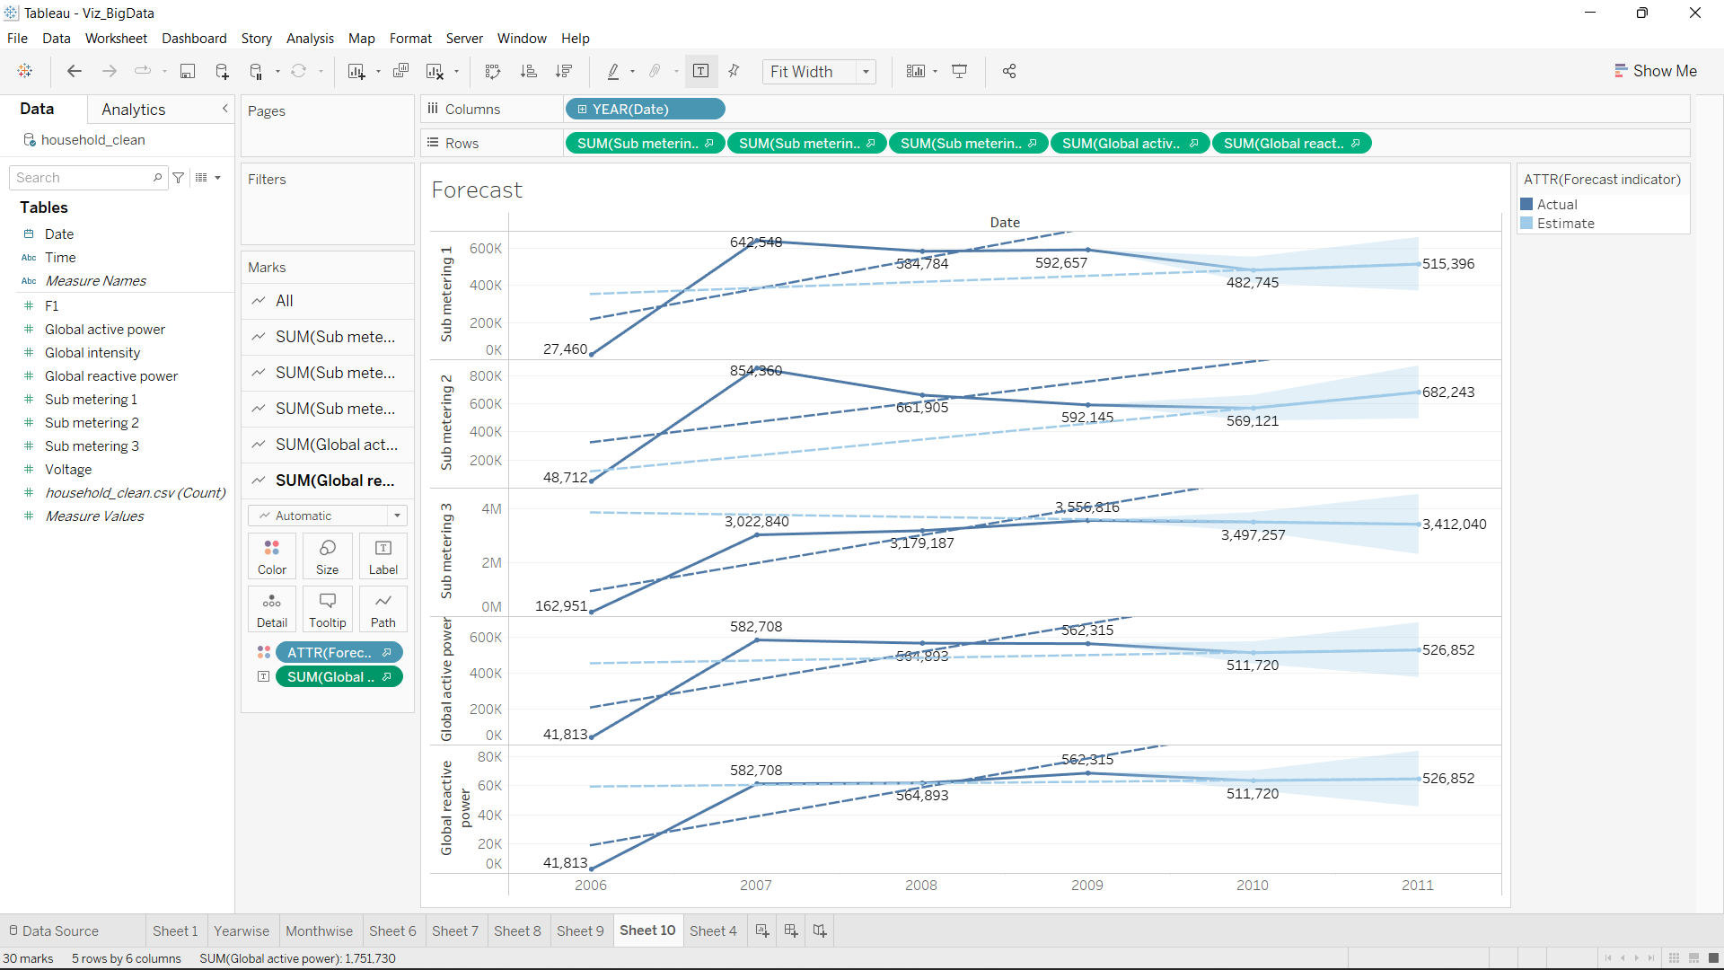
Visualizations

Slide 7
Conclusion:
Out of which Random Forest Regressor is best
Model | RMSE
Linear Regression | 0.22
Random Forest Regressor | 0.040
Decision Tree Regressor | 0.12
GBT Regressor | 0.13

Slide 8
Thank You

